Slide 1
Data Warehouse Project: User Log Information Analysis ------Mock Data Generation to Visualization
Ziyang Xu
DS5110

Slide 2
Introduction
Overview:
Project involves mock data generation, data streaming, and analysis pipeline.
Tools used: Flume, Kafka, Hadoop, Hive, Sqoop, Superset.

Slide 3
Overview:
Objectives:
Build an end-to-end data warehouse solution.
Visualize insights using a robust ETL pipeline.
Goals:
Automate data flow from generation to visualization.
Provide meaningful insights on user logs.

Slide 4
Model
XU002
LogFile
Collection
Flume
Kafka
HDFS
Data Consume
Flume
XU003
LogFile
Collection
Flume
Superset
Mysql
HIVE
Data Storage + Data Analysis
Sqoop
Data transfer

Slide 5
Literature Review
Review of Existing Data Warehouse Frameworks
Hadoop-Based Data Storage and Processing:
Hadoop Framework: Designed for distributed storage and processing of large datasets.
MapReduce: Core processing model for handling massive data in parallel.
HDFS (Hadoop Distributed File System): Enables reliable and scalable storage for structured and unstructured data.
Relevance: Provides the backbone for storing and managing the data ingested from Kafka via Flume.
Hive:
Built on top of Hadoop to enable SQL-like querying (HQL).
Handles complex queries efficiently by leveraging distributed processing.
Widely used in data warehouses for structured data analysis.

Slide 6
Mock Data
Data Type: Jason (common, actions, displays,error,ts)
Example(structure and “common”):
{
“common”:{…},
“actions”:{…},
“display”:{…},
“error”:{…},
“ts”:{…}
}
"common": { // Environment Information
"ar": "15", // Province ID
"ba": "iPhone", // Phone Brand
"ch": "Appstore", // Channel
"is_new": "1", // Whether the user is new
"md": "iPhone 8", // Phone Model
"mid": "YXfhjAYH6As2z9Iq", // Device ID
"os": "iOS 13.2.9", // Operating System
"sid": "3981c171-558a-437c-be10-da6d2553c517", // Session ID
"uid": "485", // User ID
"vc": "v2.1.134" // App Version Number }

Slide 7
Hive
Hive tables structured for queries:
Partitioned by date for performance and analysis.

Slide 8
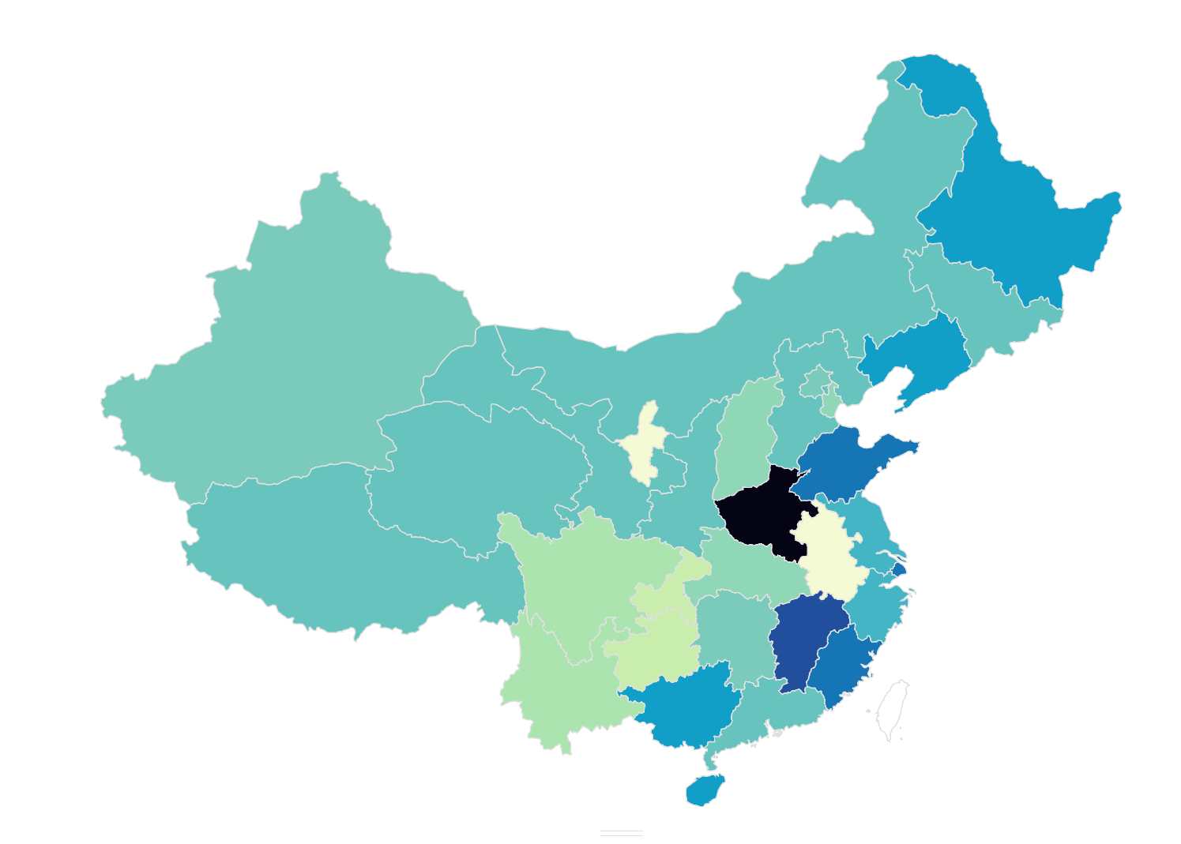
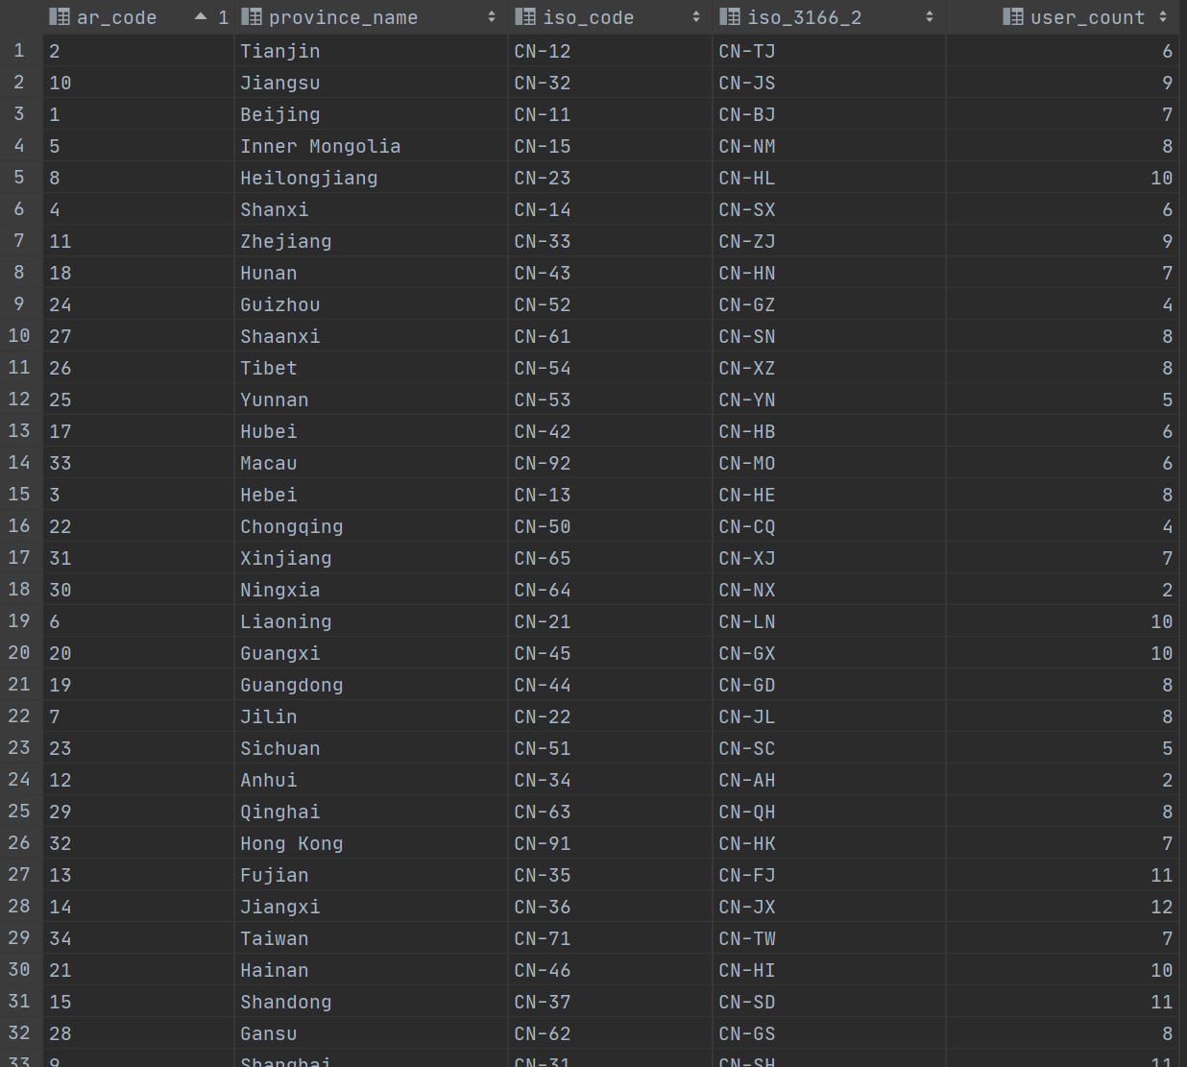
Analysis and Results

Slide 9
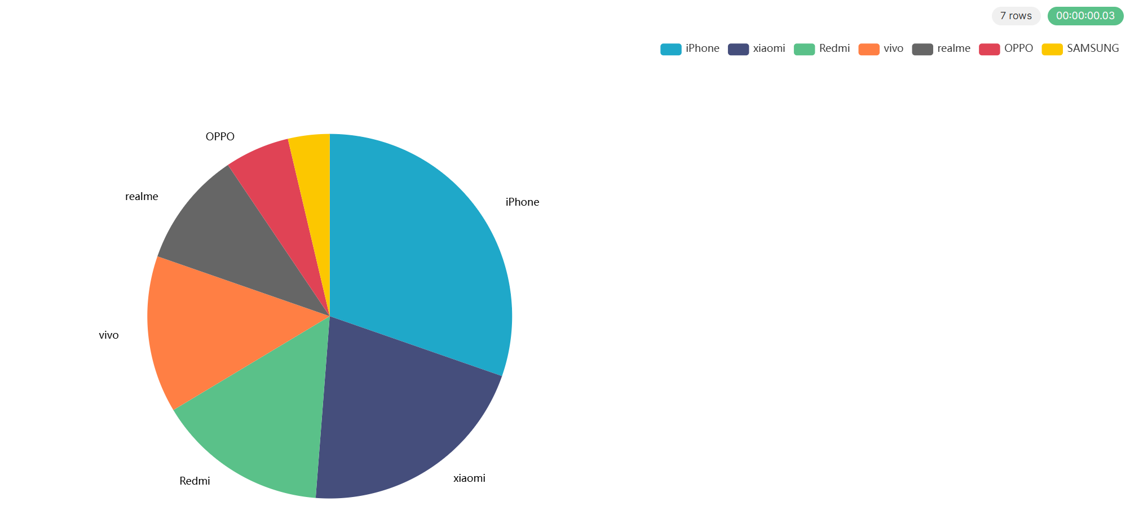
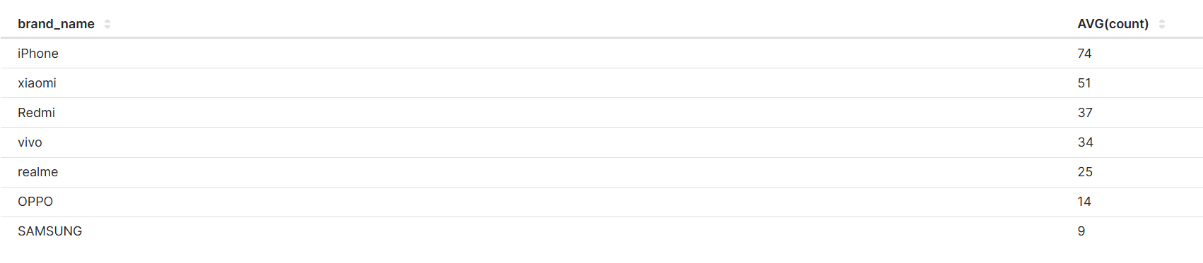
Analysis and Results
14(5.74%)
25(10.25%)
74(30.33%)
34(13.93.33%)
37(15.6%)
51(20.9%)

Slide 10
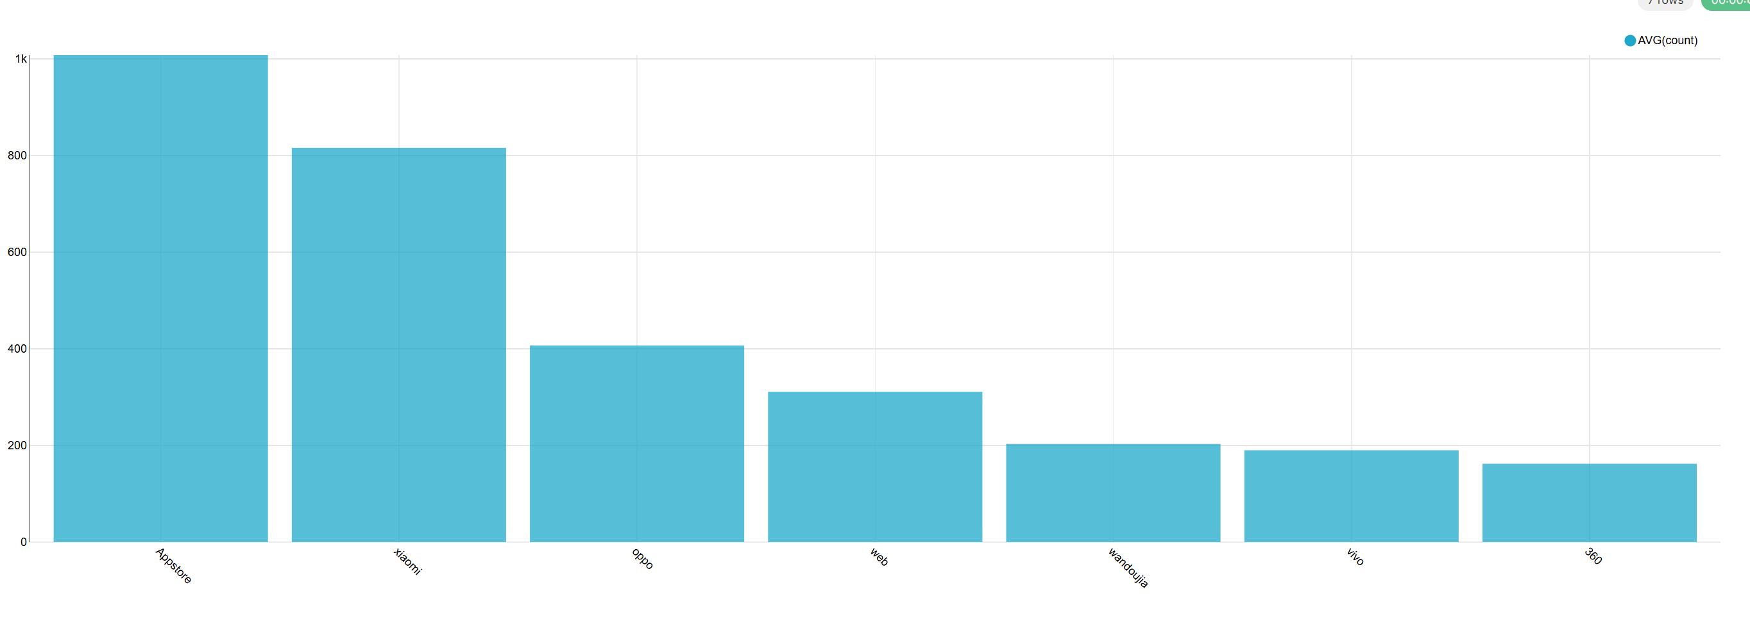
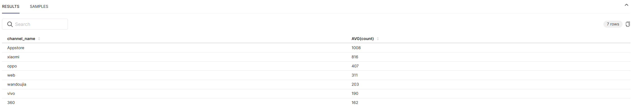
Analysis and Results

Slide 11
Hours Spent on Project
Weekly: 15 hours
Monthly: 60 hours
Breakdown:
40% Coding and Configuration.
50% Testing and Debugging.
10% Analysis and Visualization.

Slide 12
Project Limitations
Issue: Over-reliance on node XU002 due to poor distribution design
Lack of Incremental Data Synchronization

Slide 13
Conclusion
End-to-End Data Warehouse Development
Data Processing and Analysis
Tool Familiarity

Slide 14
Reference
The Data Warehouse Toolkit
Kimball, R., & Ross, M. (2013). The Data Warehouse Toolkit: The Definitive Guide to Dimensional Modeling (3rd Edition). Wiley.
Provides comprehensive guidance on designing and implementing data warehouses, including ETL workflows and dimensional modeling.
Snowflake Online Course
Data Warehousing Workshop - Snowflake (Accessed Online).
Practical insights into modern cloud-based data warehousing techniques, informing aspects of the project's methodology and tool comparisons.
Atguigu Online Course
Data Warehouse V6 - Atguigu (Accessed Online).
Comprehensive training on data warehouse concepts and implementation, covering ETL processes, Hadoop, Hive, and best practices for big data systems.
AmpCode (YouTube)
AmpCode YouTube Channel.
Tutorials and guidance on big data and data warehouse tools, including practical insights into Flume, Kafka, Hive, and Hadoop integration.
Arif Shaikh (YouTube)
Arif Shaikh YouTube Channel.
Offers tutorials on technical topics, including Hadoop, Hive, and other data engineering tools.
Data Engineering (YouTube)
Data Engineering YouTube Channel.
Covers a variety of data engineering topics, from ETL processes to data warehousing, using tools like Hadoop, Hive, and Spark.
Reddit and Stack Overflow Discussions
Multiple posts and threads provided valuable insights and troubleshooting tips for resolving technical issues encountered during the project.
Topics included:
Memory management and optimization in Hadoop.
Best practices for Hive query performance.
Flume and Kafka configuration tips.

Slide 15
Thanks!

